Slide 1
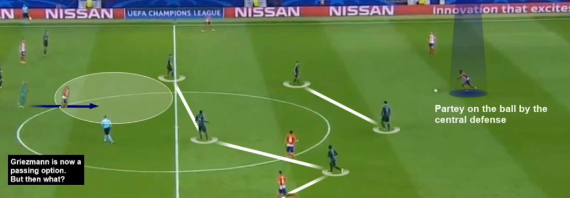
SPORTS ANALYTICS
Brøndby AS

Slide 2

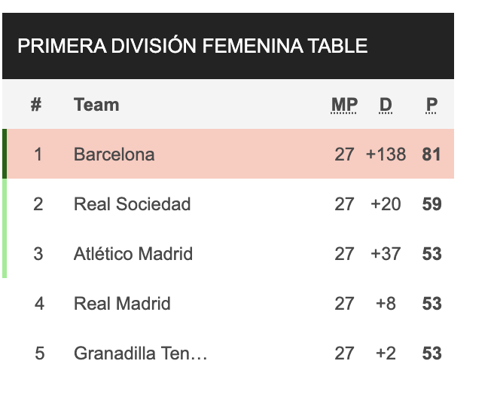

Kvinder & Fodbold

Slide 3
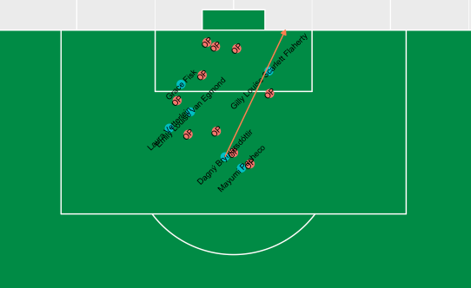
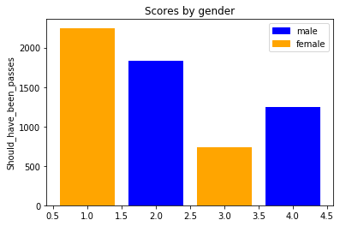
Agenda
Overview Statsbomb
lineups
events
matches
Statsbomb i Mongo
import herrekampe
Events – shots
import fra statsbomb
all shots one match
one shot – position
ggsoccer
all shots – position and arrow
one shot - freezeframe

Slide 4
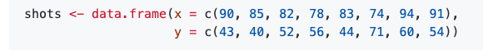
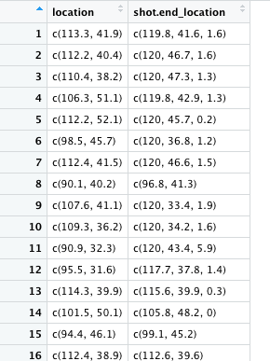
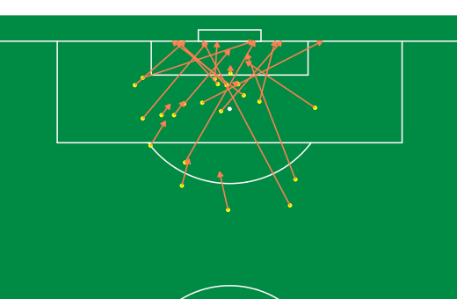
Plot all shots in one game
Kvinder & Fodbold

Slide 5
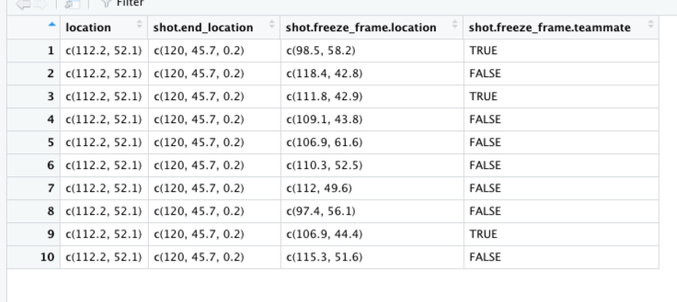
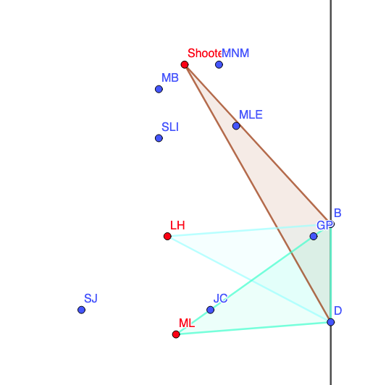
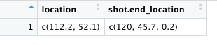
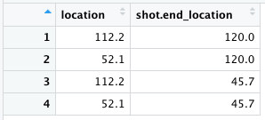
Kvinder & Fodbold
Find all non-teammates
For each teammate
compute number of nont in triangle

Slide 6
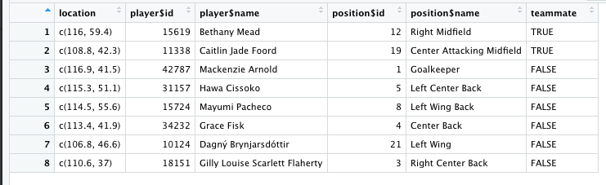
Kvinder & Fodbold
Find all non-teammates
For each teammate
compute number of nont in triangle

Slide 7
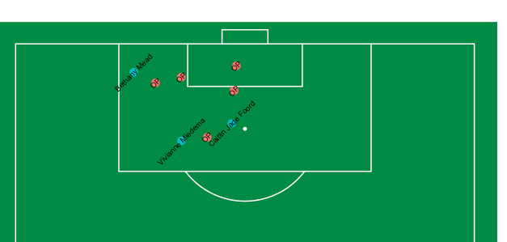
Kvinder & Fodbold

Slide 8
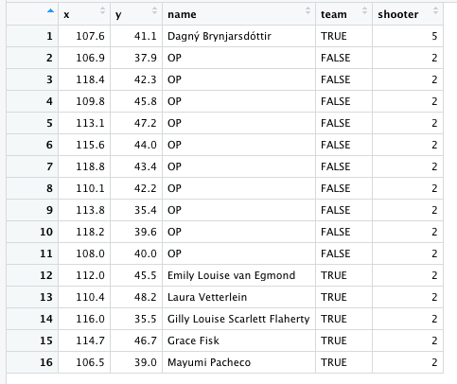
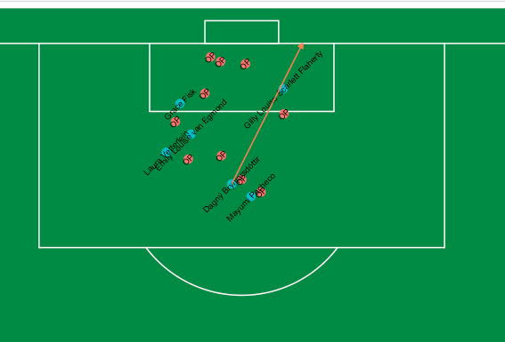
Kvinder & Fodbold

Slide 9
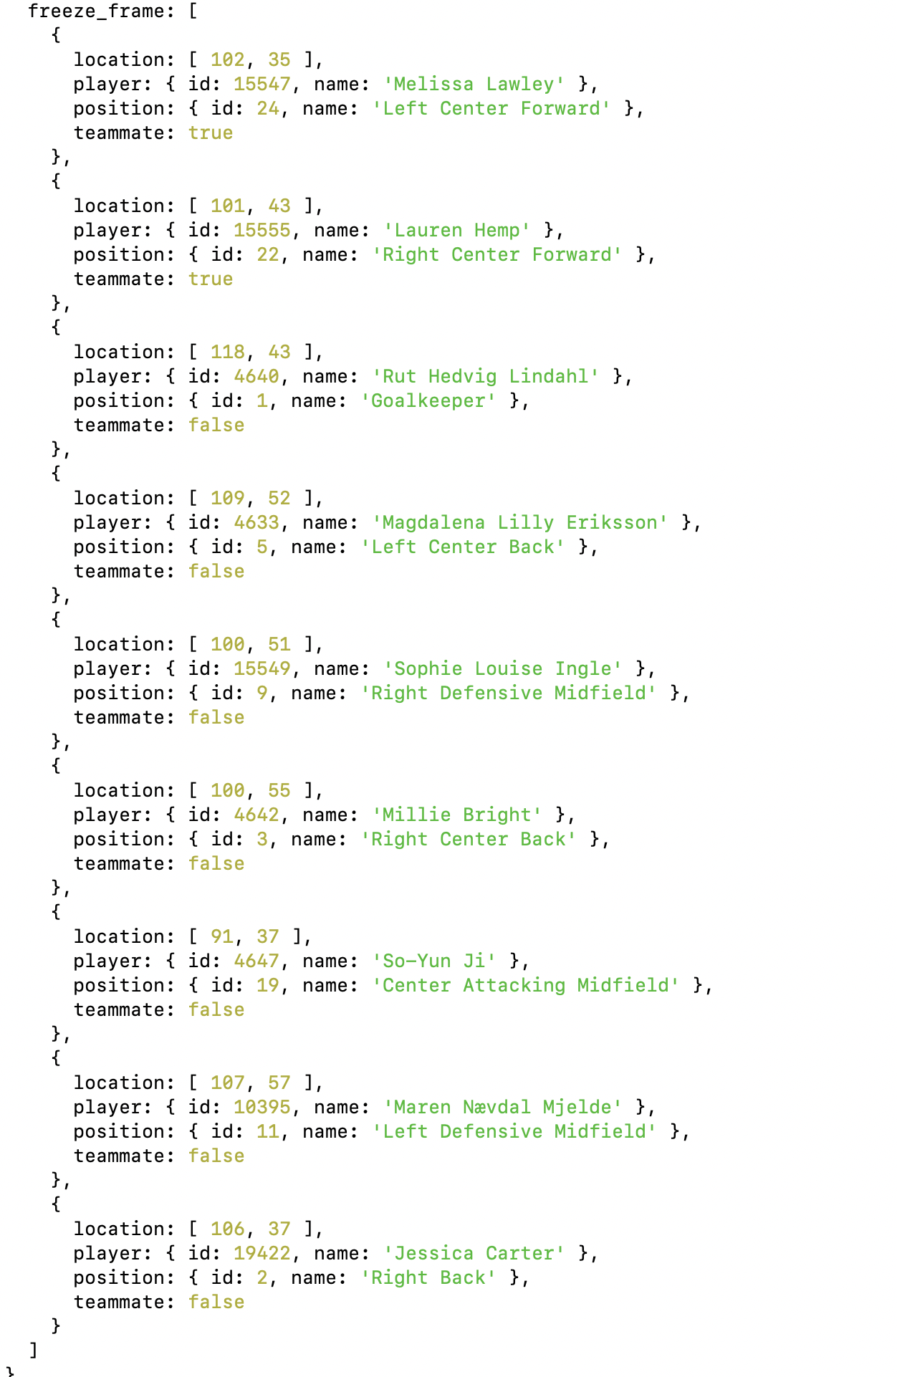
Kvinder & Fodbold
Find all non-teammates
For each teammate
compute number of nont in triangle

Slide 10
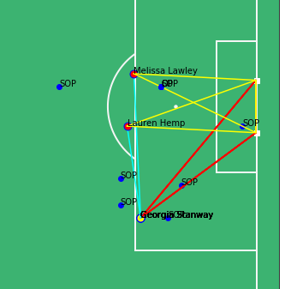
Freeze-Frame
Kvinder & Fodbold
Number of players in tri
Distance of pass to teamplayer
Distance to passline from opponent
Teamplayer xG
Distance, angle
This frame:
GS:2 in tri and gdist 24.0
ML: 2 in tri and gdist 18.6
LH: 1 in tri and gdist 19.2
GS to ML: 22
GS to LH: 14
Closest OPP to ML-pass: 2.72 / 0.12
Closest OPP to LH-pass: 2.12 / 0.15
Conlusion: Should have been a pass
If for all team-others
shooter tri < other tri
AND
Other gdist < (shooter + tol)
AND
Passdist Shooter-Other-ratio > 0.2
Then
should have been a pass

Slide 11
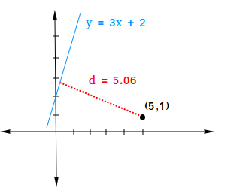
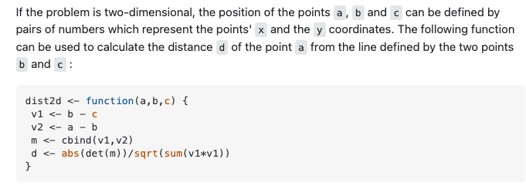
Freeze-Frame
Kvinder & Fodbold
Distance to passline from opponent

Slide 12
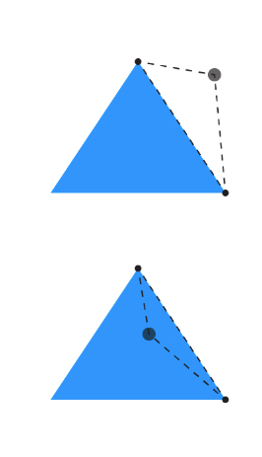
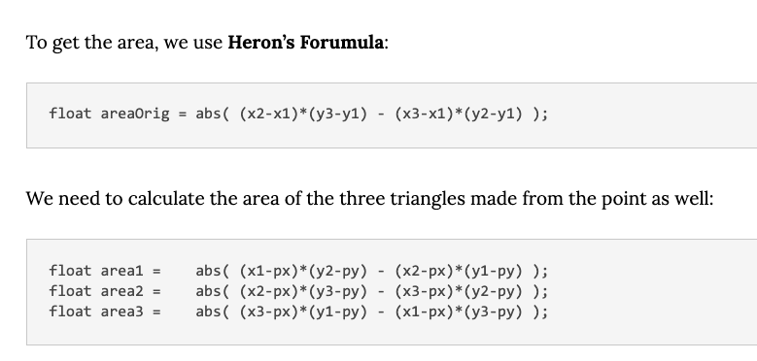
Freeze-Frame
Kvinder & Fodbold
Number of players in tri

Slide 13
Bias ..
Kvinder & Fodbold
﻿find({"type.name":"Shot", "gender":"female", "position.id" : {"$in":striker_player}})
﻿find({"type.name":"Shot", "gender":"male", "position.id" : {"$in":def_player}})

Slide 14

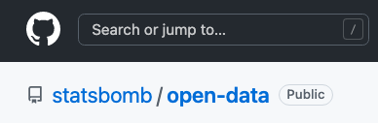
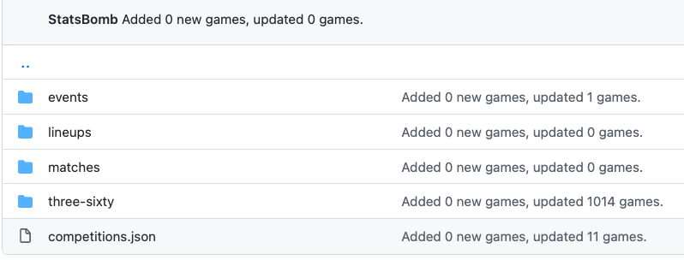
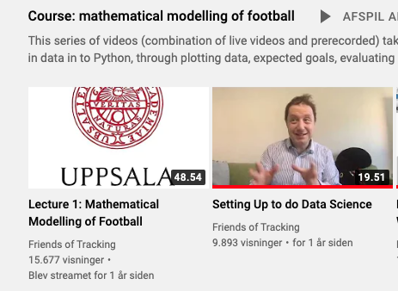
Statsbomb

Slide 15
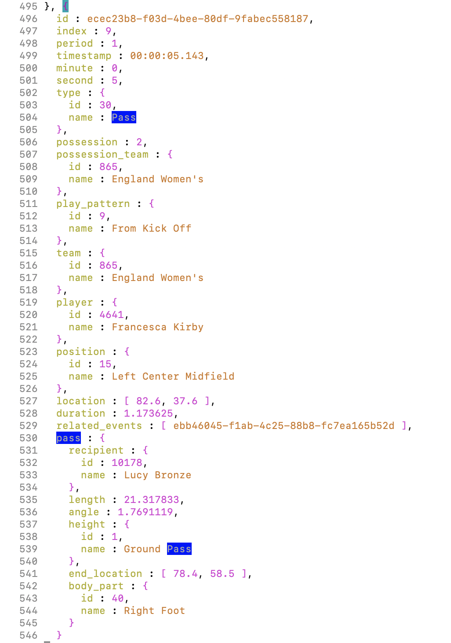
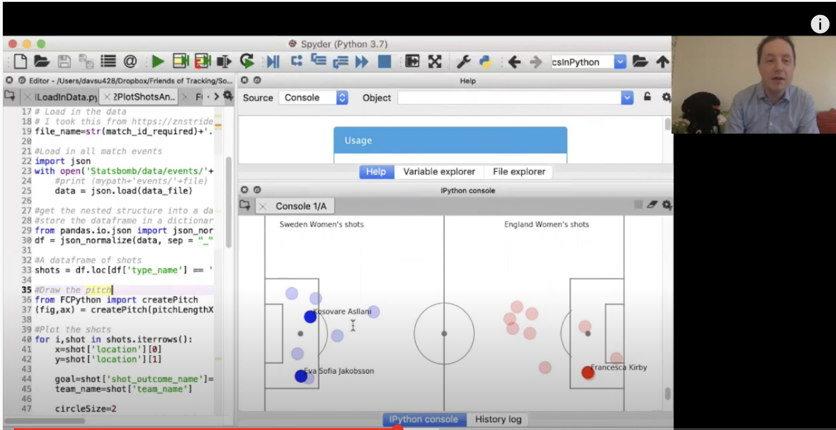
Sample event from 69301.json with 3291 events
David laver
Shots map
Passes map

Slide 17
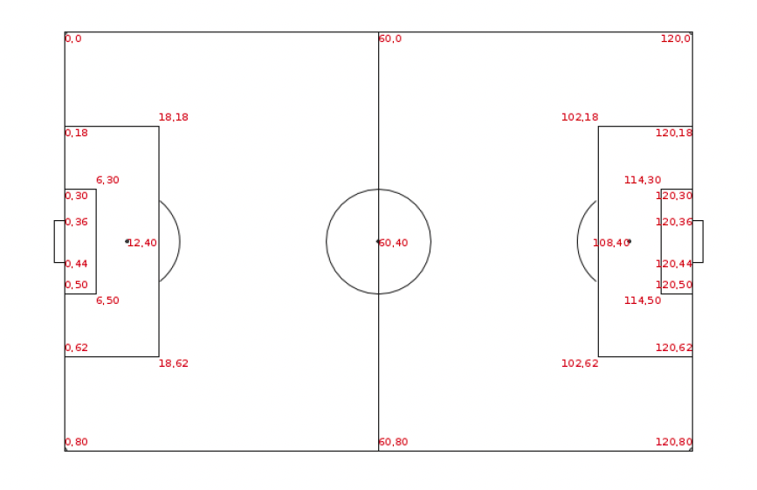

Slide 18
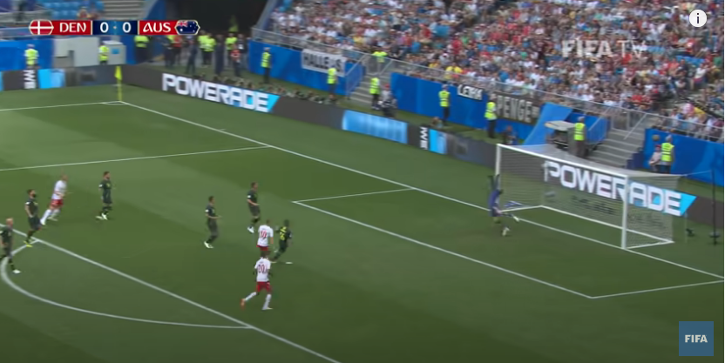

7547.json
7547.json

Slide 19
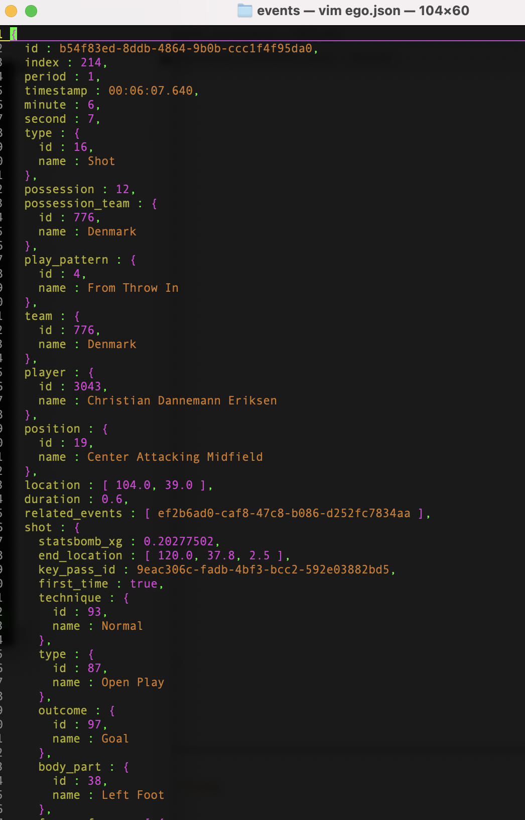
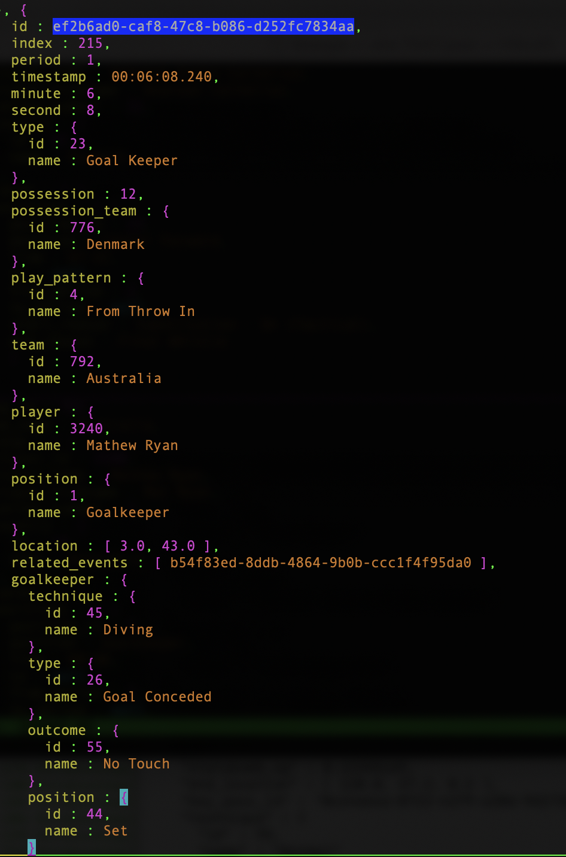

7547.json
7547.json

Slide 20
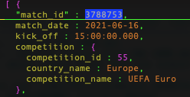


Three-sixty folderen rummer trackingdata for 51 kampe.
Desværre ikke for DK’s kampe.
3788753 er Rusland vs Finland
3788753.json har ca 3800 events
3788753.json opstillingen for de to hold
55/43.json has a record for matchid 3788753 (and 49 other games)
3788753.json has the tracking of that match

Slide 21
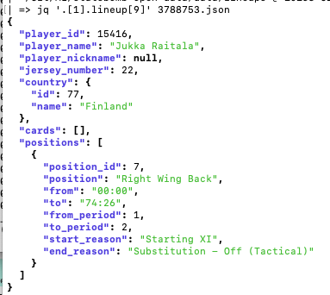
Lineups

Slide 22
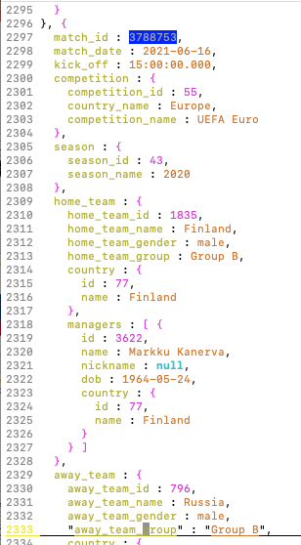
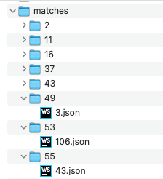
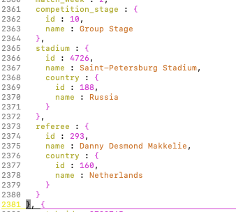
Filen 43.json
med 51 kampe

Slide 23
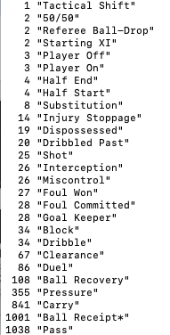
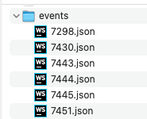
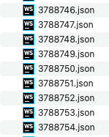
3788753.json indeholder 3806 events for kampen Rusland – Finland.

Slide 24
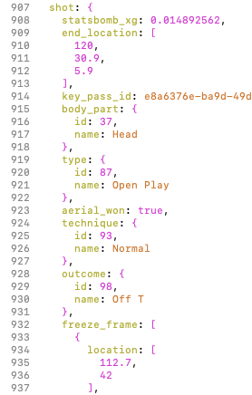
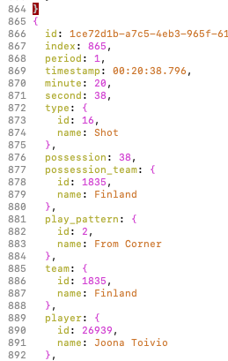
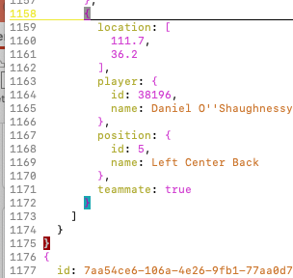
3788753.json – eksempel på skud-event.

